Slide 1

DATA PREPARATION

Slide 2





Independent vs dependent features/variables
Features:
In any dataset we can distinguish between two types of features/variables/columns:
Independent / predictive ( those that we will use to make predictions )
Dependent / Target ( WHAT want we want to predict USING the INDEPENDENT FEATURES )

Slide 3


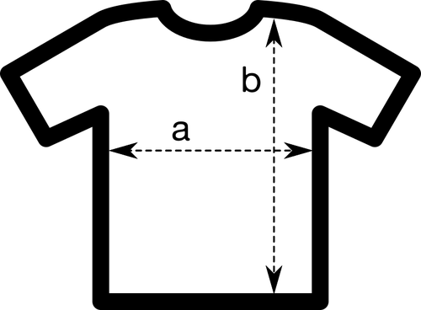
Types of features
Features:
There are always two types of features or variables:
Numerical: (numbers: 1, 2, 3…,3.15, 38.4)
Categorical (tags)
Ordinal ( they display some kind of order )
Nominal (they don’t have any order
Dates:
Usually we use date differences.
How we can distinguish between them?
Numericals express an amount (they can be added, subtracted, multiplied, divided..)
Categoricals doesn’t express an amount, express a tag.

Slide 4
Value Types found on datasets
Value types:
We can find any combination of features in a dataset:
Numerical:
Integers
Float numbers
Categorical (tags )
Characters (“a”, “b”, “W”,....)
Strings (“My car is red”, “Yahoo!”, “englishhh”,...)
Booleans ( True / False, Yes / Not)
0

Slide 5


Garbage in / Garbage out
Value types:
A model prediction will never be better than your input data!

Slide 6
Data cleaning / wrangling
Standardize column names
Deleting and rearranging columns
Working with data types (set the correct type)
Filtering data
Removing duplicates
Collecting typos
Conditional formatting
Replace missing values
00

Slide 7
Dealing with missing values
Drop rows
Drop them
Drop columns
NA’s
Custom replacement
Replace them
Imputation methods

Slide 8

Encoding data
Numerical
Features
Nominals
One Hot Encoding
Categoricals
Ordinals encoding
Ordinals

Slide 9
One Hot Encoding
Consists in getting an dataframe of binary entries for each value of the categorical column.
Color
Red
Green
Blue
Red | Green | Blue
1 | 0 | 0
0 | 1 | 0
0 | 0 | 1
Pros: Easy to automate. Cons: Increases the number of columns

Slide 10
Ordinal Encoding
Consists in assigning numerical values to each unique value of the categorical column according to an “implicit” relative ordering
Educational level | Value
Analphabet | 0
Primary School | 1
High School | 2
Bsc | 3
Ph.D. | 4

